Slide 1
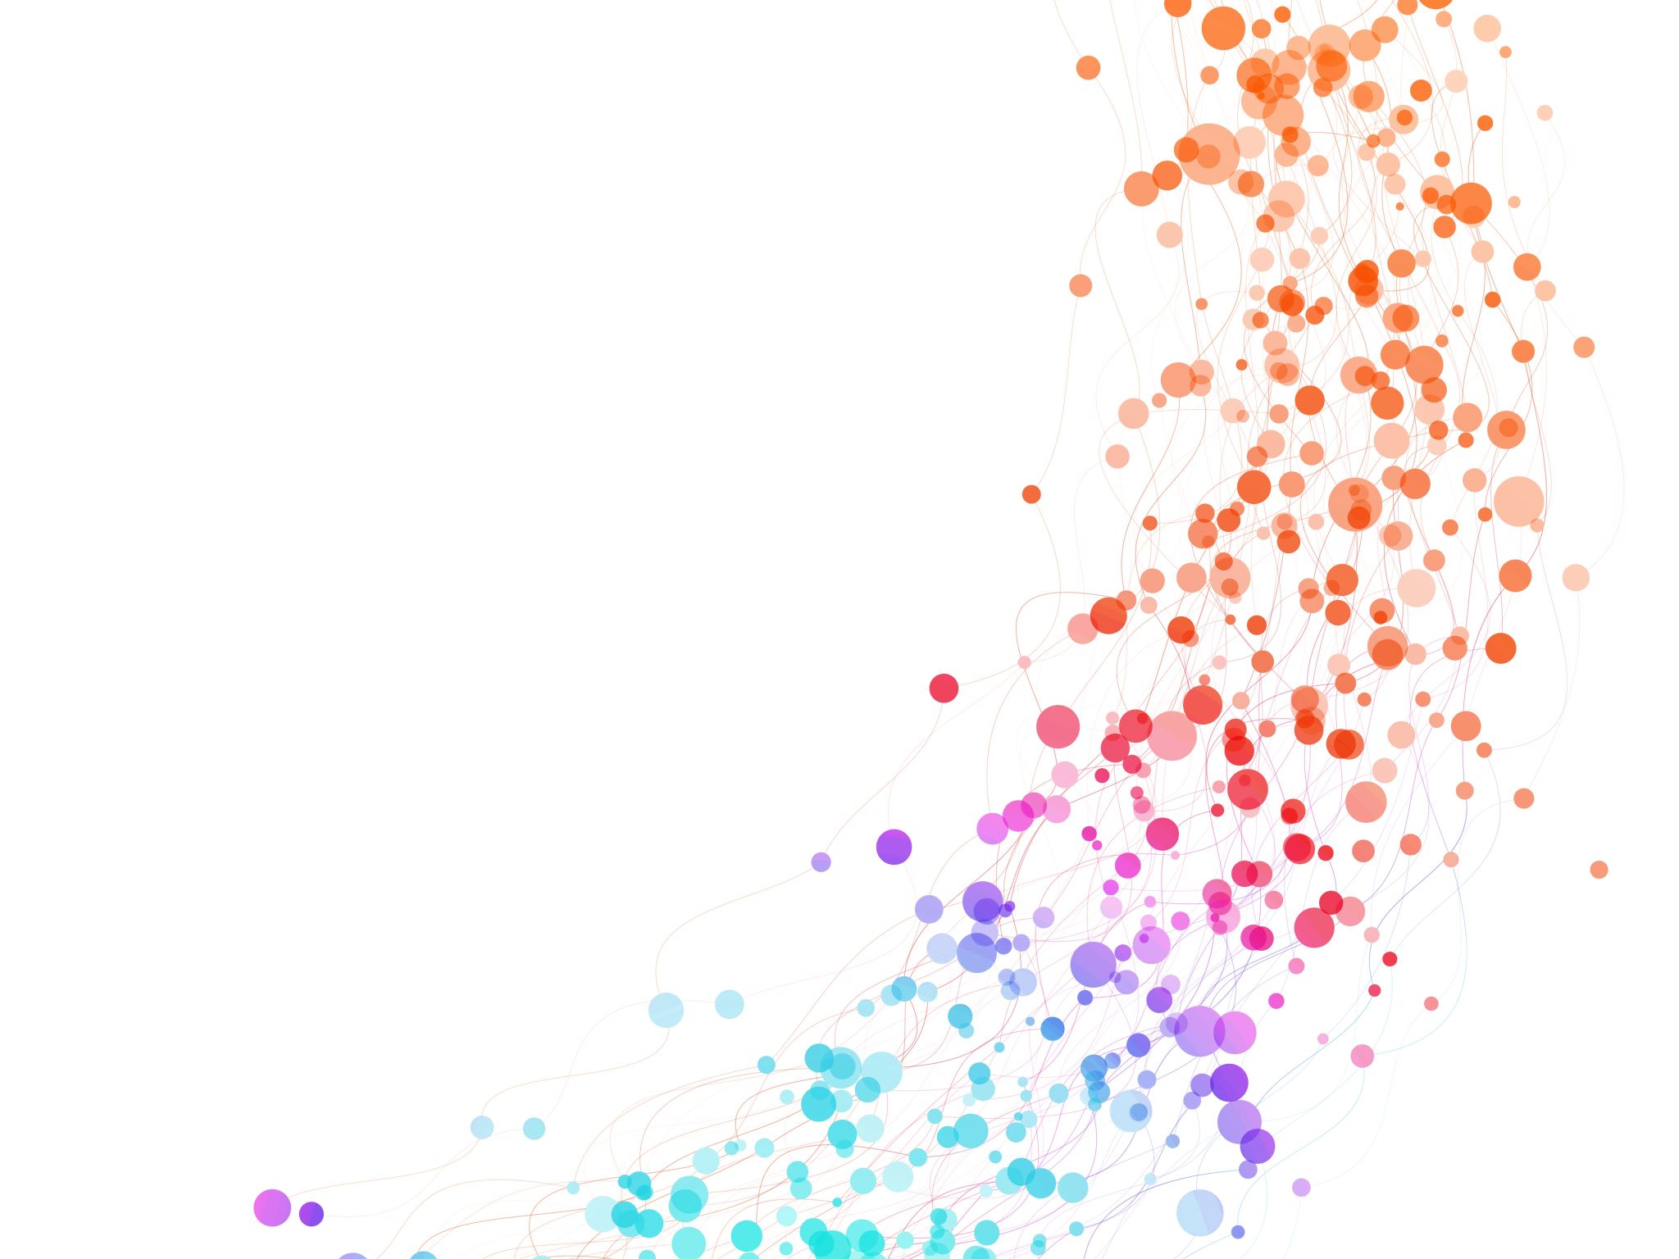
Demand Forecasting Use Case
Brenntag Data Science Assessment

Slide 2
Agenda
Key Question
Model goal
Model development process
Key data findings
EDA
Baseline model & results
Model improvements
Next steps

Slide 3
What is the potential demand for upcoming months so that team can better plan the resources?
Can we build a model to forecast the demand for upcoming months using historical sales dataset?

Slide 4
What are the key attribute of the project?
Model Goal
Dataset
Scope
Build a demand forecasting model by utilizing the historical data from 2018 onwards for products for next 6 months
Dataset 1 – Historical product Order dataset
Dataset 2 – Inflation dataset
3 Product lines – Sugar, Citric Acid, Gelatin
Risk
Forecasting and S&D may not be aligned depending upon the external market influencing factor
2 Geographies – EU, APAC

Slide 5
Agenda
Key Question
Model goal
Model development process
Key data findings
EDA
Baseline model & results
Model improvements
Next steps

Slide 6




High level demand forecasting system design
Model is built using historical data and provides raw forecast, to make the output more accurate, we can add a layer of business rules/SME inputs and modify the forecasted demand
Order data
Inflation
Forecasting model
Raw Forecasted demand
Add Business Knowledge
Modified Forecasted demand
Supply/ Inventory Manager
* Analytics can be added using Tableau/PowerBI

Slide 7
Iterative model development approach is used to develop the model for the project
We start with baseline, and eventually get into improvement phase of the model using feedbacks
Exploratory Data Analysis
Feature engineering
Model development
Results
Business Hypothesis
Feedback
Business Involvement

Slide 8
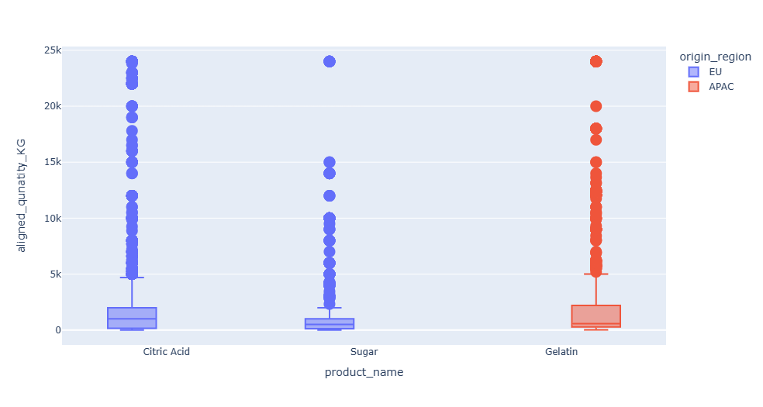
EDA -1 Products have similar quantity distribution but fully segregated based upon the region

Slide 9
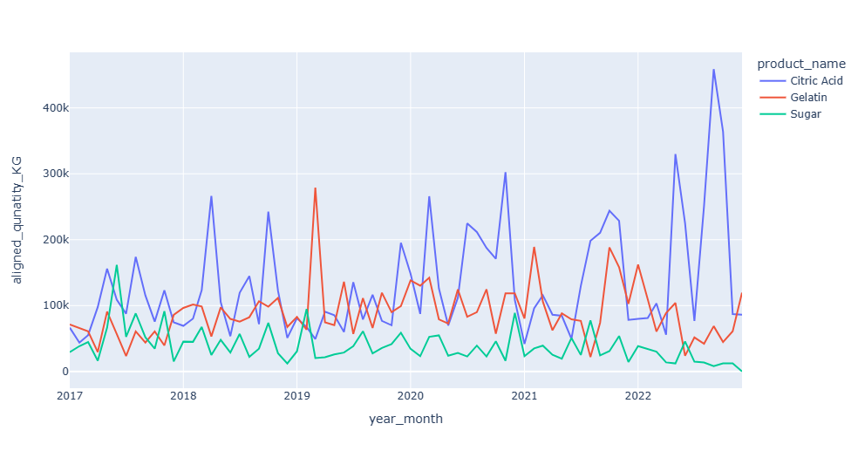
EDA -2 There is some level of seasonality and trend in the demand, sugar is seeing downtrend

Slide 10
Key Assumptions
Quantity is scaled up/down to KG and it will not have impacts.
Removed the quantity lesser than 10KG, impacted 3 old records
Each product demand needs to be predicted, not region wise
Short term forecasting is needed

Slide 11
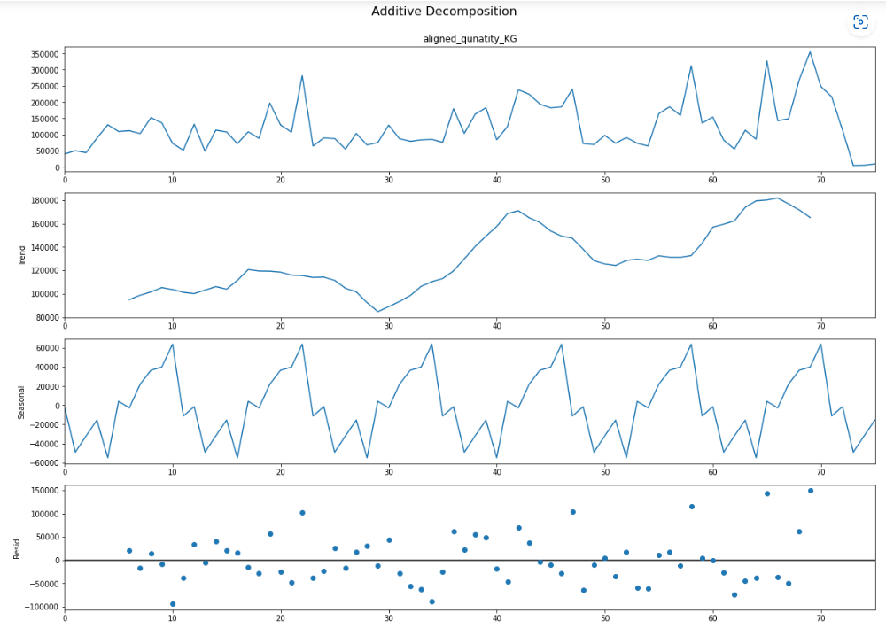
Results – Seasonality test on 12 months lag Citric Acid
*we have similar seasonality in other products

Slide 12
Results –Model
Tested multiple models but the performance of the models are not good.
Model | MAPE | Decision
ARIMA | ~40% | Not a good model, Test the boosting algo
Catboost | ~109% | Model downgrades
FBProphet | ~533% | Way off from the reality
Conclusion – Model needs to be improved.
Need to do additional tests on the data,
Add additional feature
Change the aggregation level from 1 month to weekly
Use inflation as a key driver with demand

Slide 13
Next Steps
We can do experiments with hyperparameters of the models
There are missing months when no transactions happened, we can find better ways to imputes those months
Further we can test out few rule-based approaches.
Ex. Model should never recommend higher that annual maximum values
Get SME inputs

